Slide 1


LIPID IN CLINICAL PRACTICE: ASIAN PERSPECTIVE
LUU NGAN TAM, MD PH.D
CLINICAL NUTRITION DEPARTMENT
CHO RAY HOSPITAL- VIET NAM
VietSPEN- HoSPEN

Slide 2
WHY DO WE NEED LIPIDS?

Slide 3
NUTRIENTS
MACRONUTRIENTS
MICRONUTRIENTS
GLUCID/
GLUCOSE
(4kcal/1g)
PROTID/ AMINOACID
(4kcal/1g)
LIPID/FATTY ACID
(9kcal/1g)
MINERAL
VITAMIN
FIBER
WATER

Slide 4
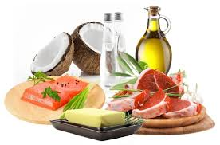
Serve primarily as a dense source of cellular energy¹
Be the components of cell membranes, second messengers in cellular signaling cascades, precursors of modulators of inflammation and platelet .
Serve as substrate for de novo biosynthesis of cholesterol and endogenous steroids¹.
Regulate gene expression²
Fell GL. Adv Nutr 2015
Hise M, Brown JC. The ASPEN Adult Nutrition Support Core Curriculum. 2nd Edition, 2012.

Slide 5
Current Guidelines for USING INTRAVENOUS lipid EMULSION (ILE) IN CLINICAL PRACTICE

Slide 6
INTRAVENOUS LIPID EMULSION AS AN INTEGRATED PART IN parenteral nutrition (PN)
Total parenteral nutrition: if enteral nutrition is contraindicated
Supplemental PN: if EN could not achieve nutritional requirement.

Slide 7
INDICATIONS FOR PN IN SURGERY
PN shall be administered as soon as possible if nutrition therapy is indicated and there is a contraindication for enteral nutrition (EN), such as in intestinal obstruction .
If the energy and nutrient requirements cannot be met by oral and enteral intake alone (<50% of caloric requirement) for more than seven days, a combination of enteral and parenteral nutrition (PN) is recommended .
Preoperative PN shall be administered only in patients with
malnutrition or severe nutritional risk where energy requirement cannot be adequately met by EN. A period of 7-14 days
is recommended.
Weimann A et al. CN 2021

Slide 8
INDICATIONS FOR PN IN ICU
In case of contraindications to oral and EN, PN should be implemented within three to seven days.
Early and progressive PN can be provided instead of no nutrition in case of contraindications for EN in severely malnourished patients .
In patients who do not tolerate full dose EN during the first week in the ICU, the safety and benefits of initiating PN should be weighed on a case-by-case basis.
Singer P et al. CN 2019

Slide 9
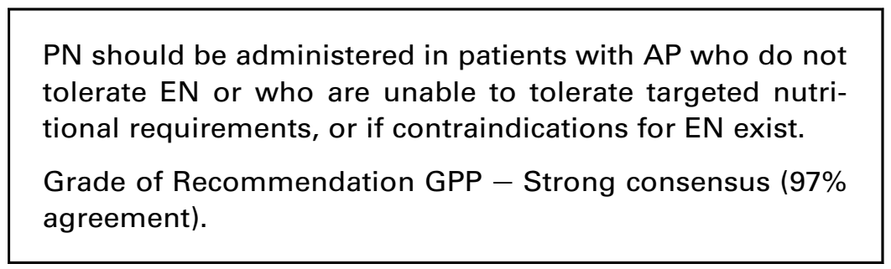
IN severely ACUTE PANCREATITIS
Arvanitakis M et al. CN 2019

Slide 10
Lipid usage in pn
Prevent caloric deficit, malnutrition and malnutrition related complications.
Prevent essential fatty acid deficit
Avoid overdose of glucose and hyperglycemia in PN
Improve nitrogen balance
Enhance wound healing
Limit fluid volume and avoid fluid overload
Modulate inflammation and immunity

Slide 11
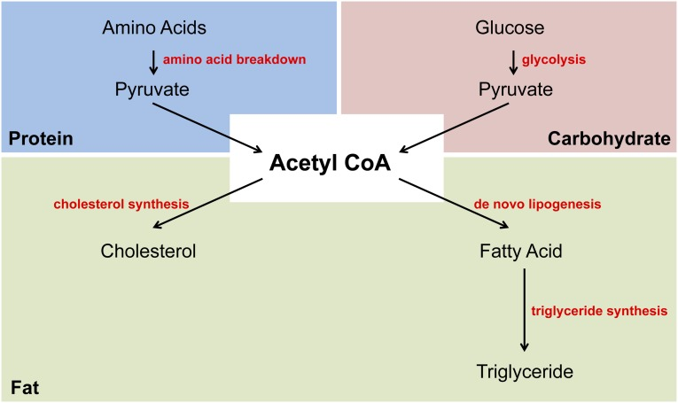
WHAT HAPPENS IF Long term PARENTERAL NUTRITION without lipids?
Hyperglycemia
Fatty liver disease
Insulin resistance
Essential fatty acid deficiency
Fell GL. Adv Nutr 2015

Slide 12
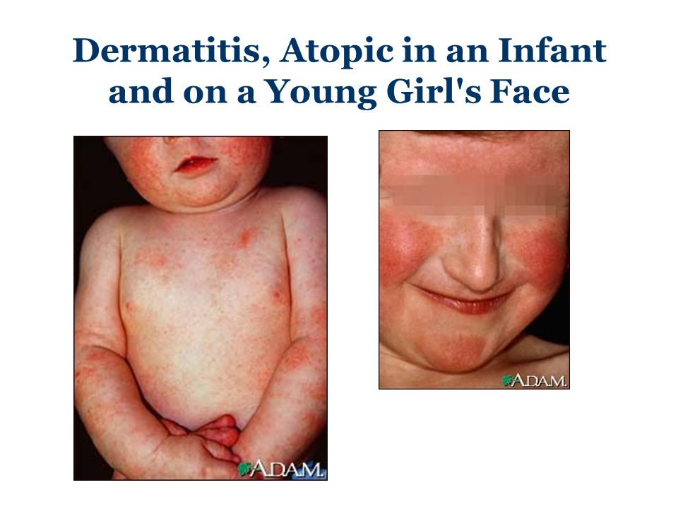
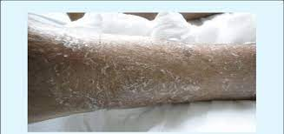
Essential fatty acid deficiency
Dermatitis
Growth retardation
Poor wound healing
Increased susceptibility to infection
Fatique
Thrombocytopenia

Slide 13
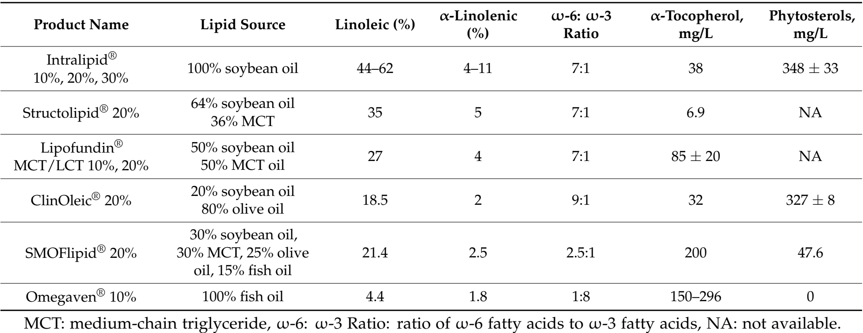
Available iles in clinical practice

Slide 14
Lipid Use in Hospitalized Adults Requiring Parenteral Nutrition
Intravenous lipid (including non-nutritional lipid sources) should not exceed 1.5 g lipids/kg/day and should be adapted to individual tolerance.
We recommend assessing serum TG at the baseline in all patients.
The concentrations of triglycerides (TGs) in serum should be within local or regional guidelines, and should, in general, not exceed 400 mg/dL (4.5 mmol/L) during infusion.
If the level is high, ensure the blood sample was drawn from an appropriate location.
Mayer K et al. ournal of Parenteral and Enteral Nutrition 2020

Slide 15
CONTRAINDICATIONS/ use with caution for ILE

Slide 16
CONTRAINDICATIONS or use with caution
Severe hyperlipidemia (hypertriglyceridemia –associated acute panreatitis).
Critically ill adults with shock.
Embolism.
Severe liver insufficiency.
Undefined coma status.
Recent cardiac infarction.
Raman M et al (2017). Parenteral Nutrition and Lipids. Review. Nutrients, 9, 388

Slide 17
Effects of FATTY ACID in ile on
CLINICAL outcome

Slide 18
GENERATIONS OF ILE HAVE MANY EFFECTS ON Inflammation and immunity
Genaration I (60s)
Lipigold 10%
Lipovenous
Combilipid/ MgTan
Gen II
(80s)
Lipofundin 10/20%
Nutriflex lipid peri
Gen III
(90s)
SMOF Lipid 20%
SMOF Kabiven
Lipidem
Gen IV
(90s)
Clinoleic 20%
PeriOlimel N4
Olimel N9

Slide 19
DIFFERENT CHARACTERISTICS OF FATTY ACID IN LIPIDS: INFLAMMATORY AND CELLULAR IMMUNE EFFECTS
 | SOYBEAN OIL | OLIVE OIL | FISH OIL
Predominant fatty acids: | ω-6 PUFA (≥2 double bonds in carbon chain)¹ | ω-9 MUFA (1 double bond in carbon chain)¹ | ω-3 PUFA (≥2 double bonds in carbon chain)¹
Inflammatory effects: | Promotes inflammation (in excess)¹ | Relatively neutral¹ | Less pro-inflammatory¹
Immune effects: | Promotes immunosuppression (in excess)¹ | May preserve immune function¹ | May promote immune function¹
Oxidative stress: | Increased risk for oxidative stress and more susceptible to lipid peroxidation² | Lower risk for oxidative stress and less susceptible to lipid peroxidation^{1,2} | Increased risk for oxidative stress and more susceptible to lipid peroxidation²
Calder PC, et al. Clin Nutr 2018;37:1–18.
Calder PC, et al. Intensive Care Med 2010;36:735–49.
Notes:
Use this slide to go into more detail on the different characteristics of soybean oil, olive oil and fish oil in terms of their fatty acid make-up, inflammatory effects and cellular immune effects.
Soybean oil is a source of the essential ω-6 PUFA, linoleic acid. Linoleic is a precursor of pro-inflammatory mediators. In excess, linoleic acid fatty acid is considered to promote inflammation and immunosuppression.
Fish oil is a source of ω-3 PUFA. It is considered to have anti-inflammatory effects and to promote immune function.
In contrast, olive oil, a source of ω-9 oleic acid (MUFA), is relatively neutral in its physiological effects, including on inflammation and immune function.
KEY POINT: The lipids commonly used in PN have different inflammatory and immune effects. Olive oil may preserve immune function.
Reference
Calder PC, et al. Clin Nutr 2017;37:1–18.

Slide 20
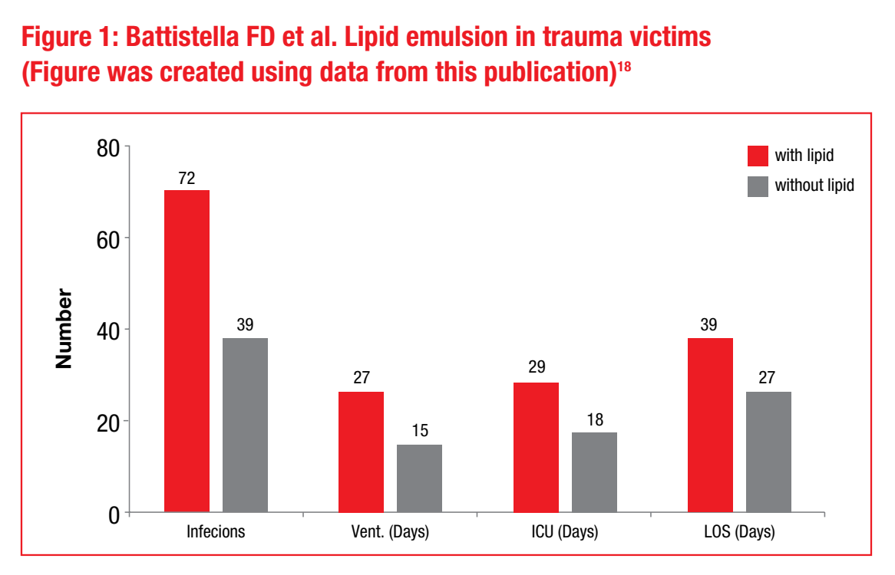
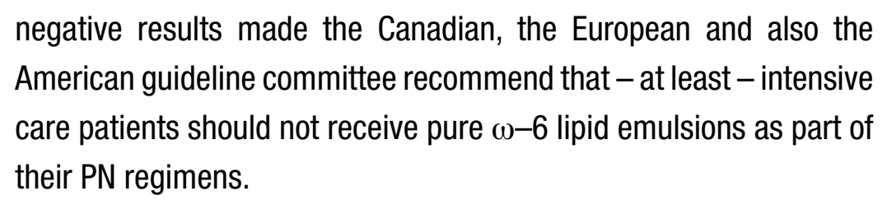
LIPID generation I
(soybean oil, rich in OMEGA 6 fatty acid)
60 trauma patients with a severity score of 27 and an APACHE II score of 23 to 10 days of postoperative PN with or without an ω–6 emulsion .
Kreyman G. S Afr J Clin Nutr 2010
Notes:
. Patients who received the lipid emulsion had a longer length of hospitalisation (39 vs 27 days), a longer length of stay in the intensive care unit (29 vs 18 days) and more days of mechanical ventilation (27 vs 15) (Figure 1) The group which received the lipid emulsion also had a significantly reduced natural and lymphokine activated killer cell activity and a higher number of infections (72 vs 39)

Slide 21
Lipid generation ii
(50% MCT + 50% soybean oil)
MCT: a chain length of 8 resp. 10 carbon atoms are derived from coconut oil.
As an instant energy source
A mixture 50/50 of ω–6 FA and MCT (ω–6/MCT) could
  Prevent the inhibition of lymphocyte proliferation
  Reduce natural killer cell activity
  Increase the expression of adhesion molecules, as well as the phagocytic capacity of the RES.
  However, as there are no harmful results, ω–6/MCT lipid emulsions are still in use and may still be used in critically ill patients
Kreyman G. S Afr J Clin Nutr 2010

Slide 22
GENERATION III
(based on OMEGA 3 fatty acid from fish oil)
In many in vitro and ex vivo studies it could be shown that ω−3 fatty acids had strong anti inflammatory and immunosuppressive effects:
inhibited lymphocyte proliferation
decreased natural killer cell activity
as well as monocyte chemiluminescence, chemotaxis and adhesion to endothelial cells.
reduced the release of proinflammatory cytokines.
Kreyman G. S Afr J Clin Nutr 2010
Notes:
The next lipid emulsion – introduced in 1991 – was based on ω−3 fatty acids derived from fish oil (FO)

Slide 23

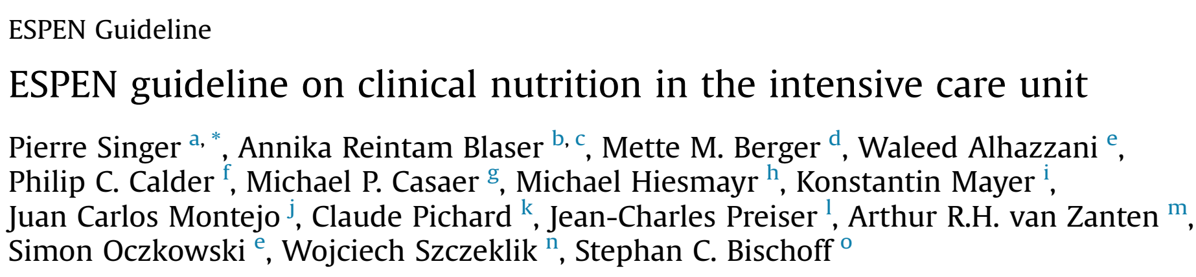
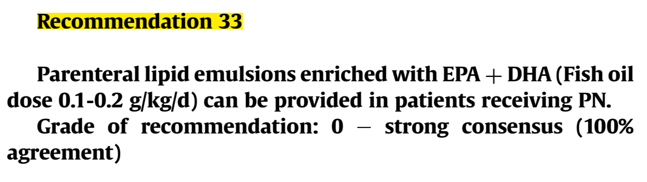

Slide 24

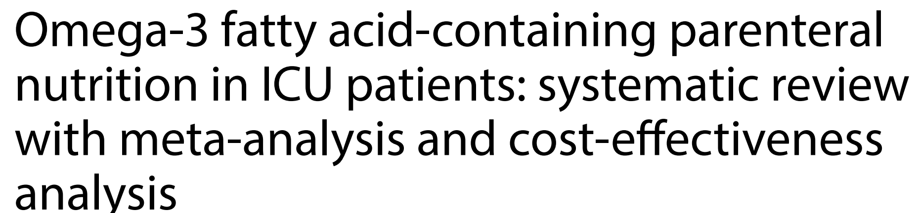

Slide 25
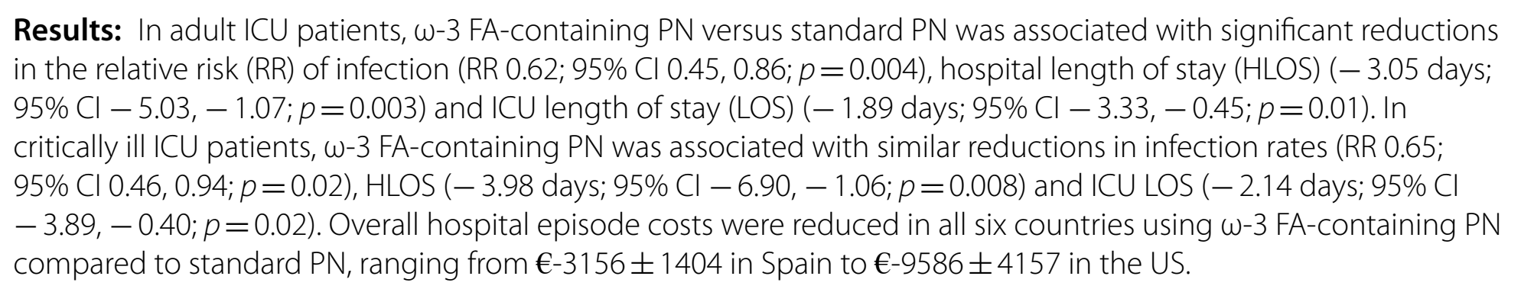
CLINICAL OUTCOME WAS IMPROVED IN GROUP WITH OMEGA 3 FA CONTAINING PN

Slide 26
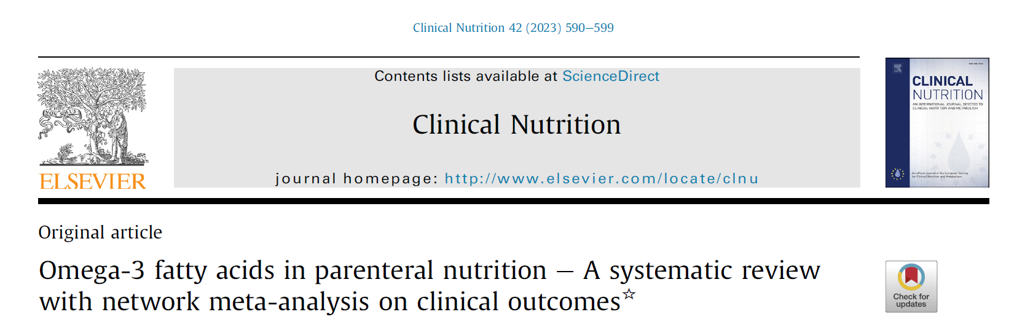
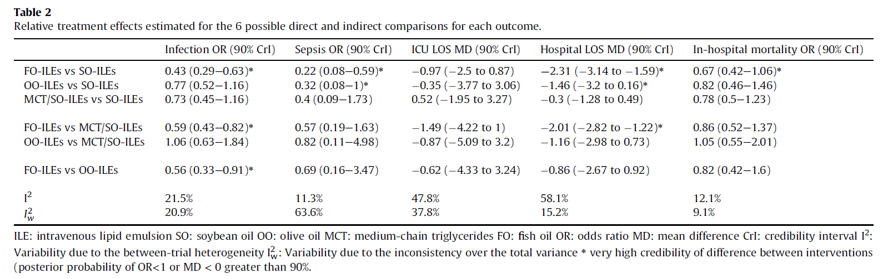
L. Pradelli, K. Mayer, S. Klek et al. Clinical Nutrition 42 (2023) 590-599

Slide 27
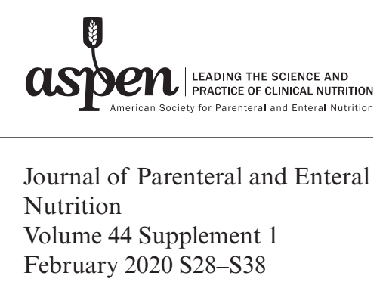
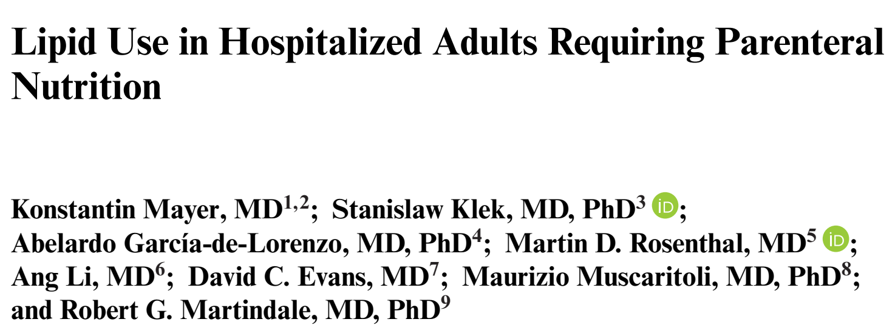

Slide 28
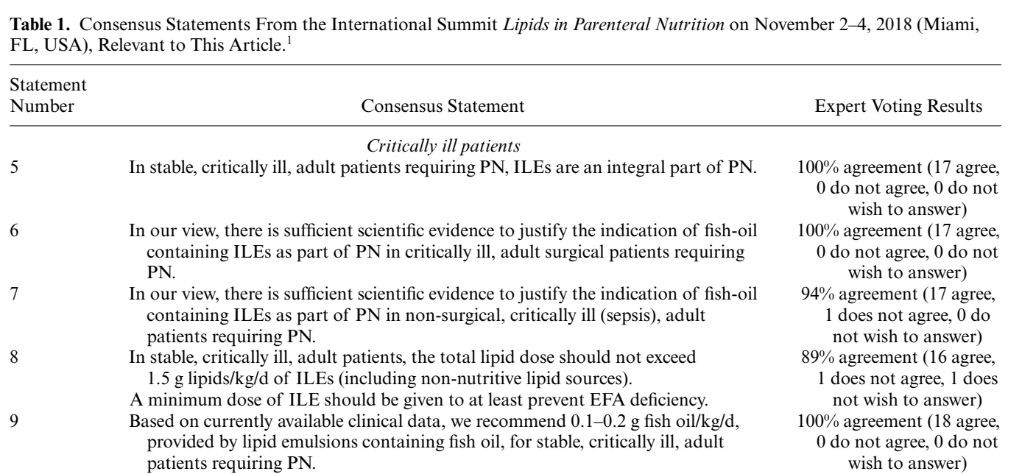
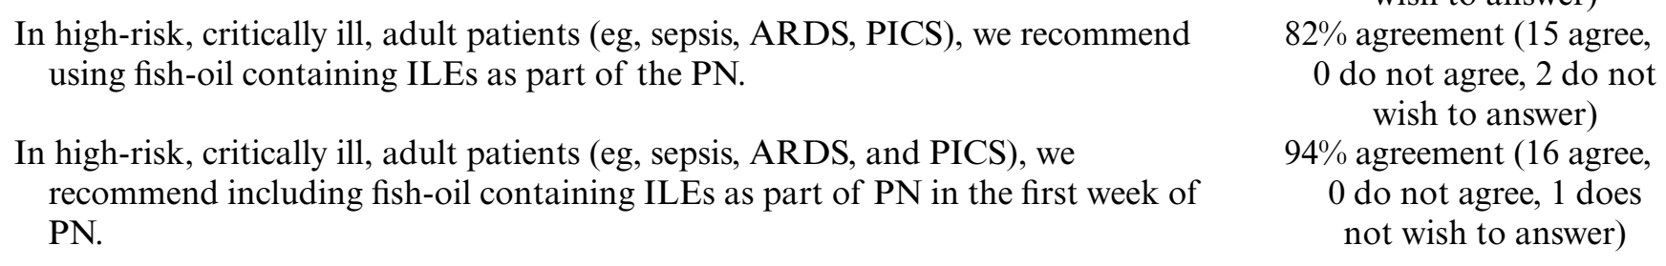

Slide 29
GENERATION IV
(80% olive oil + 20% soybean oil)
Formular with reduced ω−6 FA content to 20% and ω−9 oleic acid from olive oil (OO) to 80%.
This new emulsion was that the low content of ω−6 FA might lead to a deficiency in essential Fas
Effects:
  Not inhibit lymphocyte proliferation
  Not reduce the expression of activation markers on granulocytes
  Almost no effect on the release of proinflammatory cytokines
  Thus, its effect on most immunologic parameters was almost neutral.
Kreyman G. S Afr J Clin Nutr 2010
Notes:
The last generation lipid emulsion was introduced in 1996.

Slide 30
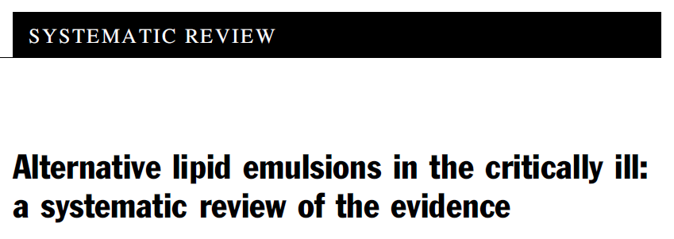
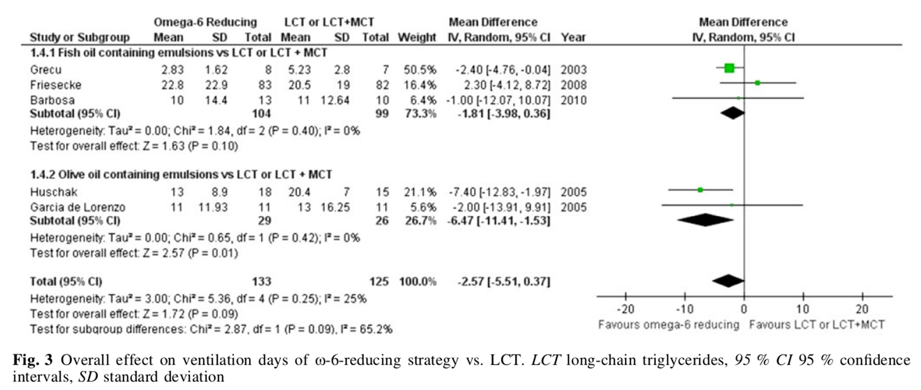
A significant shorter length of ventilation and a significantly shorter length of stay in the ICU in the high dose ω−9/ω−6 group.
Manzanares W, Dhal iwal R, Jurewitsch B, Stapleton RD, Jeejeebhoy KN, Heyland DK. Intensive Care Med. 2013;39(10):1683-1694
Notes:
. The trial reported by Huschak57 randomised 33 severe multiple trauma patients to either high dose ω−9/ω−6 (75% of non-protein energy) or normal dose ω−6 FA (37% of non-protein energy).

Slide 31
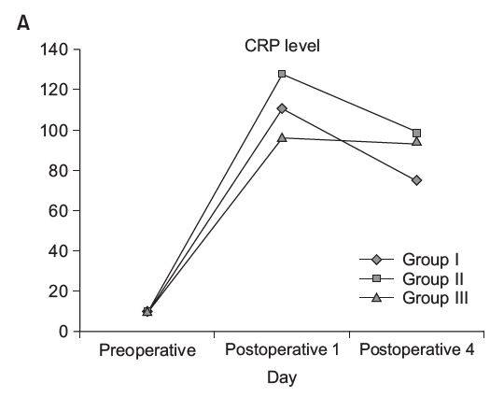
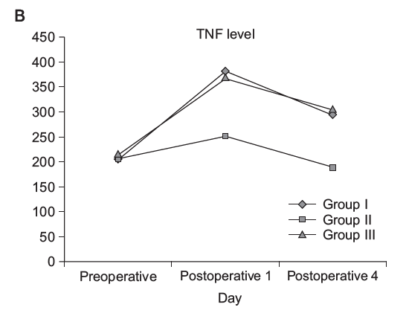
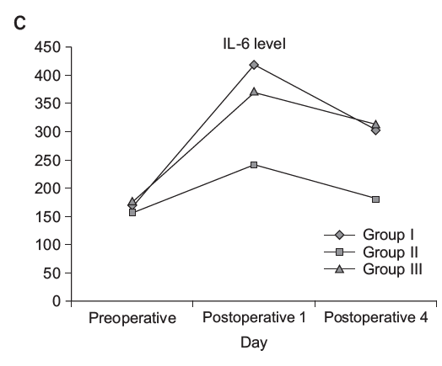
Assessment of inflammatory and immunological parameters,CRP (A), tumor necrosis factor (TNF)-α (B), and interleukin (IL)-6 (C) levels, before and after the operation.
Group I, soybean oil + MCT; Group II, soybean oil + olive oil; Group III, soybean oil + olive oil + fish oil.
Annals of Surgical Treatment and Research 2016;91(6):309-315
Notes:
The postoperative increases of circulating CRP and TNF-α concentration did not differ between the study groups but after 4 days of PN, plasma TNF-α and IL-6 concentrations were lower in patients receiving the olive oil based lipid emulsions.
Surgical trauma induces a general inflammatory response [10]. Systemic proinflammatory mediators increase early, followed by an elevation in systemic IL-6 that triggers the initiation of acute phase response. Some patients show an early hyperinflammation that might be damaging to the host. The hyperinflammatory response is characterized by overproduction of TNF-α, IL-1β IL-6, and IL-8.
A compensatory anti-inflammatory response syndrome follows the acute phase response and more immunoneutral lipids as olive oil may be beneficial in this phase.

Slide 32
IN CONCLUSION
Lipid has an important role in parenteral nutrition, especially in critically ill patients requiring PN.
ILE has been evolved from traditional lipid emulsions containing only soybean oil as a lipid source to now moving those containing multiple lipid components (MCT, fish oil), olive oil.
ILE with reduced soybean oil has potential benefits in clinical outcome.

Slide 33
THANK YOU SO MUCH FOR PAYING TO ATTENTION!

